Slide 1
Upending the Supply Stack: Variable and Responsive Resources as Primary Objectives
June 2011 Meeting of
the Massachusetts Restructuring Roundtable
Presented by Richard Sedano
June 10, 2011

Slide 2
Introducing RAP and Rich
RAP is a non-profit organization providing technical and educational assistance to government officials on energy and environmental issues. RAP Principals all have extensive utility regulatory experience.
Richard Sedano directs RAP’s US Program. He was commissioner of the Vermont Department of Public Service from 1991-2001 and is an engineer.

Slide 3
Premise
Energy and the environment are inextricably linked

Slide 4
Changes afoot
Environmental Imperatives
Expensive base load options
Costs for variable resources (wind and solar) are dropping
Costs for responsive resources (supply and demand) appear stable or improving
Supply of demand resources likely enhanced by smart grid and improved market rules

Slide 5
Turning the supply stack on its head
Many are conditioned to start building a supply portfolio with base load sources
The name says it all
Lots of energy available all the time
Fill in the high spots with generation that cost less to build and maintain at the ready (intermediate and peakers)
Variable resources sub for intermediates and peakers

Slide 6
In a Wholesale Market, How Do We Get the Generation We Want (Need?)
Owing to a synthesis of environmental and reliability imperatives:
What if the eastern interconnection needs 30% wind and solar by 2030 in order to meet 2050 carbon goals in an orderly and economical way?
40%?
50%?

Slide 7
Brief History of Power Sector Resources
In the beginning, utilities planned and acquired resources
Just and reasonable rates
No undue discrimination
Reliability
1970s: Disruptions in Confidence
Clean air and water
Expensive oil
Nuclear calamity

Slide 8
Government Rouses in Response to Performance
Cost Disallowances
Public Planning
Competitive Generation
Wholesale Markets Reforms
Retail Markets and Restructuring Utility

Slide 9
Balance of Markets and Authority Unsettled
States lose influence to guide planning and especially investment
Reliance on markets means refining market rules, consistent with reliability
New principles, new institutions
Open access
ISO, RTO

Slide 10
Doubling Down on Markets
RTOs, where they exist, take on responsibility not just for reliability and market administration, but also for planning
Policy issues rest uneasily on RTO managers
Interest-based governance and voluntary nature accent influence of traditional resource owners
States uneasy with their lack of control of outcomes
Demand resources undervalued

Slide 11
Status
There is enough power, but many problems
Aging, polluting, congesting, (add yours)
Market rules retain bias
But they are consistent, respect precedents, and are within the Federal Power Act
Demand resources undervalued
Energy resources undervalued
Very responsive resources undervalued
Polluting resources overvalued
States frustrated to varying degrees

Slide 12
Toward Better Decisions (Defining “Better”)
How shall US Power Sector Decision-makers align economic regulation with environmental goals?
Focus only on reliability and markets won’t do
Market Pushing state policies like RPS and net metering help but are rough
Carbon price – most anticipate it already

Slide 13
Clean First
Clean resources as important as reliability and fair markets
Lisbon treaty language
Redefine “undue discrimination” and “just and reasonable”
Risk aware
Calibrate markets and rules to clean portfolio results

Slide 14
Lisbon Treaty of European Union
Article 11 of Principles
Environmental Protection requirements must be integrated into the definition and implementation of the Union’s policies and activities, in particular with a view to the promotion of sustainable development.

Slide 15
Clean First
Address bias in choices on wholesale market rules based on current perspectives
Reliability standards can be accomplished with multiple design philosophies
Fair markets can depend on your point of view
Absolutes are fewer than they might appear

Slide 16
Clean First Policy Categories
Transmission Pricing and Access
Capacity Markets
Dispatch
Ancillary Services
Transmission Planning and Siting
State initiatives

Slide 17
Transmission Pricing and Access - 1
New interconnections
Managed queue gives priority to clean resources to address delay and uncertainty
Recognize shared grid value in interconnection

Slide 18
Transmission Pricing and Access - 2
Interconnection Cost Allocation
Network costs based on all relevant factors, including network environmental factors
Consistent with beneficiary pays dicta
Redefines beneficiary value to include environment

Slide 19
Transmission Pricing and Access - 3
Firm Transmission Access
Address financial certainty of clean resource projects, drives changes in operations to anticipate higher renewable penetration
Conditional firm service with much longer duration, or, better…
System design paradigm based on grid sharing and optimizing (managing) to change imperative of service to more polluting resources to curtailing them, produce FTR for renewables

Slide 20
Transmission Pricing and Access - 4
Transmission Rate Design
Energy basis, not capacity, to remove bias favoring high load factor resources
Reflect long run marginal cost
New Transmission
Incentives to favor facilities enabling connection of non-polluting resources
Non-wires alternatives required, paid same as transmission (see planning)

Slide 21
Capacity Markets
Produce right capacity in right places
Non-polluting
Enabling non-polluting (dispatchable, responsive demand, storage and supply)
Payments, Auction winners differentiated by pollution costs, energy benefits
Phase out capacity payments to polluting resources
Differentiation already occurs between new and old

Slide 22
Dispatch
Environmental Dispatch
Efficiency (heat rate) Dispatch
Operations including demand resources

Slide 23
Ancillary Services
Specific to supporting renewable resources
Valuing dispatchable and responsive resources needs a reset
Encouraged by new FERC NOPR
“Frequency Regulation Compensation in the Organized Wholesale Power Markets
Applies directly to RTO regions only
Notes:
Why do we need more and faster responsive resources? Variable resources – wind and solar.

Slide 24
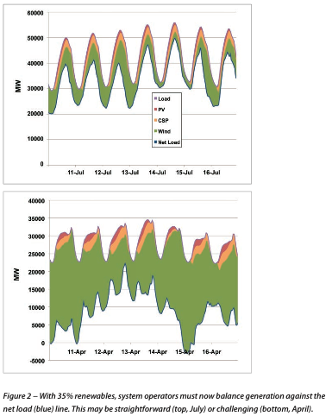
With 35% renewables, system operators must now balance generation against the net load. This may be straightforward (top, July) or challenging (bottom, April)
Green is wind
Western Wind and Solar Integration Study (WWSIS)
NREL May 2010

Slide 25
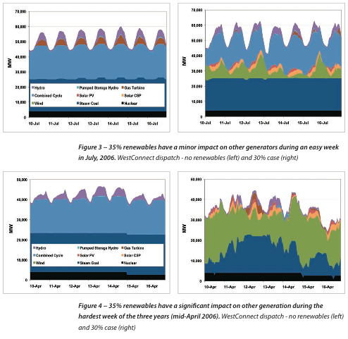
35% renewables have minor impact on other generation in July
35% renewables have significant impact on other generation in April

Slide 26
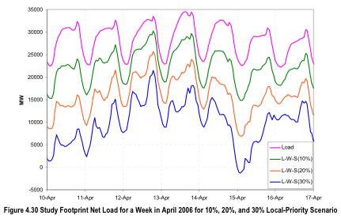
Net loads in April at three RE penetration levels

Slide 27
The Graphic I Want to See
Load (adjusted for EE)
Minus intermittent renewables (W-S)
Minus base load generation
Leaves load to be served by dispatchable resources
Today, forecasted 30% renewables, that graphic would show too much base load, not enough dispatchable

Slide 28
Growing Variable + Responsive
As wind and solar capacity rises, the amount of responsive resource needed to enable full use of this variable energy will rise, perhaps increasing compensation, perhaps drawing more suitable resources into the market
A response that simply curtails wind and solar is not consistent with environmental goals

Slide 29
Transmission Planning and Siting
Scenarios reflecting clean resource investment with plans to achieve them
Interconnection planning
Renewable Energy Zones
Valuing system value of Non-wires Alternatives (equate to paying for transmission)
“National Interest Renewable Transmission”

Slide 30
Public Policy Overlays - 1
Directives
Energy Efficiency Standard
Loading Order
Renewable Energy Standard
Clean Energy Standard
DG Policies
Environmental regulation
Generation Performance Standard
Or an Emissions Portfolio Standard
Statutory Limitations

Slide 31
Public Policy Overlays -2
Considerations
Land and Water use
Prospective carbon limits
Cost
Local control or influence
Markets and Competition
Diversification
Energy Security (Yes! Still on this list!)
Emerging end uses (transportation)

Slide 32
Is Bias so Bad?
Regulators don’t want to “pick winners”
Reliability and market rules strive to treat competitors fairly and assure safe, reliable svc.
If planning process only gets us enough power…
How do we get the energy supplies we want?
Policy is already guiding “winners”

Slide 33
What if Clean First takes hold?
Environmental considerations are as important as reliability
Could influence generation queue, access, operating rules (imbalance penalties, dispatch)
Markets in service of reliability and environment
Redefine “just and reasonable rates”
Redefine “undue discrimination”

Slide 34
What can states do? A Starter’s List
Renewable energy zones – consider building enabling transmission to where wind (location-constrained resource) is
Reassess value of dispatchable resources (supply and demand) for higher wind volumes
Coordinated procurement of renewables (+?)
Use participant funding of transmission to assert participant priority rights
Assess strategy for managing “reasonably foreseeable” new EPA regulations and effects on generating fleet, as Colorado has done
State transmission authorities (more directed)

Slide 35
Richard Sedano
rsedano@raponline.org
802 498 0710

